Slide 1
LED Modules for Pentaphilia

Slide 2
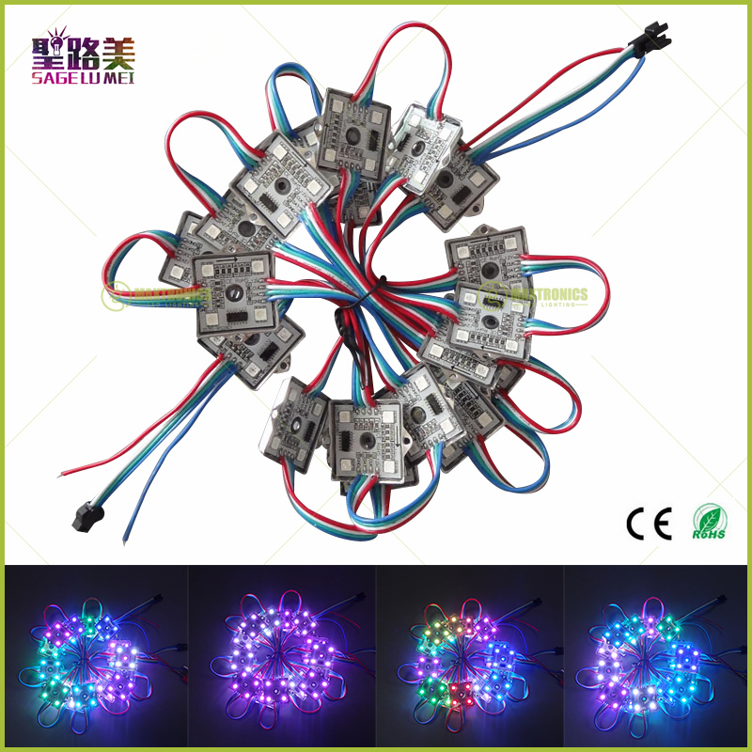
Background
WS2811 or WS2801 addressable modules.
Modules come in 20 modules/string.
Strings can be customized for wiring length.
Strings have male and female terminators suitable for serial chaining.
Electronics are potted, waterproof and dust-proof.
Module casing has centered screw-down point.

Slide 3
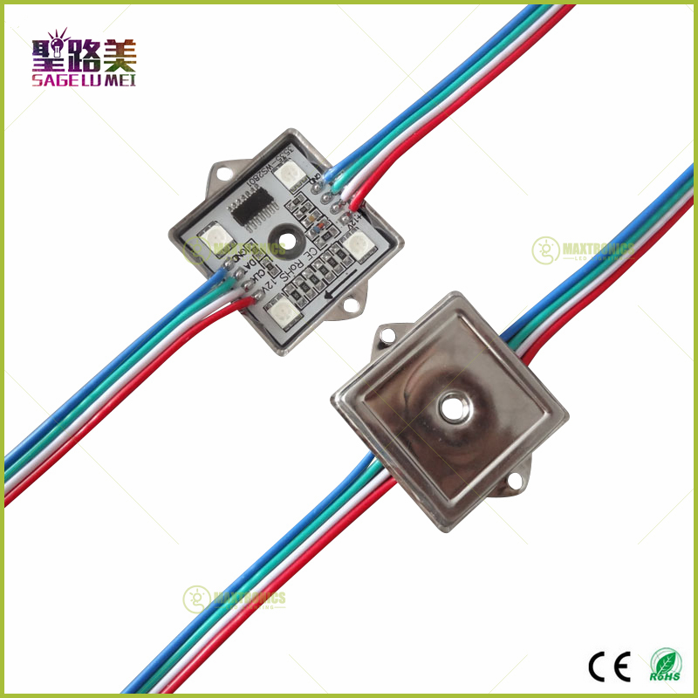
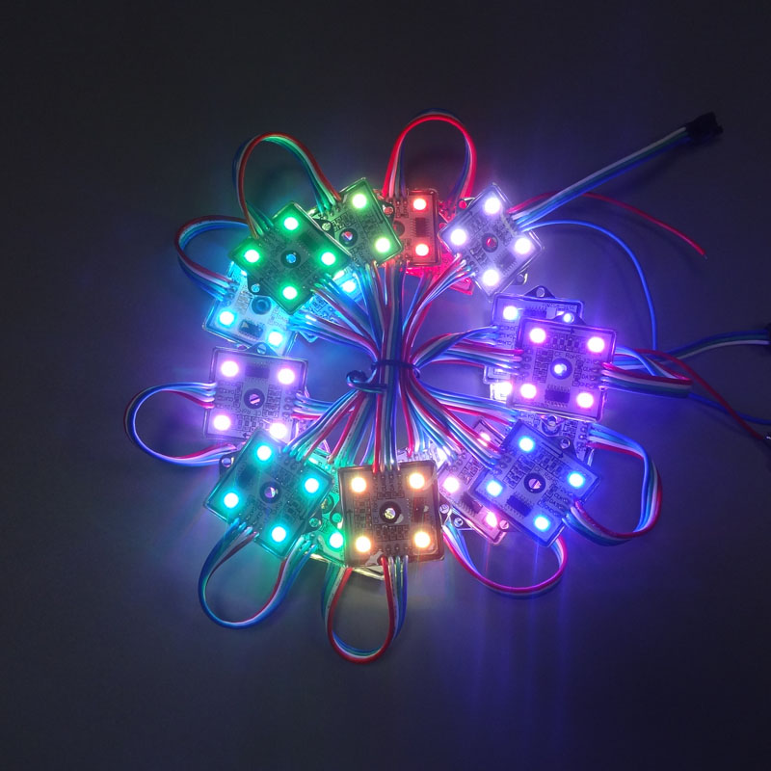
Shots

Slide 4
Cost information
$0.65/module * 20 module/string= $13/string
1 string/P = $26/DP = $3250
1 string/DP = $13/DP = $1625
Editorial from Mike:
This is an extremely efficient way light, control, wire, power supply a DP for < $30.
S&H: $2/string
1 string/P = $250
1 string/DP = $500
Allen Shi: Hello Michael, ws2801 4leds pixel module light custom wire lengths: 50cm between each module, 200cm at the beginning and end of each string, snap-together connectors at each end, extra wires for GND and +12VDC. 250 strings with 20 pieces per string. we can give you the best price 0.65usd/pcs.(custom made price) 250strings total 250*20=5000pcs, 5000pcs total 0.65*5000=3250usd. Shipping cost to USA by FedEx total 481.50usd so total 3250+481.50=3731.50usd. delivery time: one week. Hope to get your reply soon! Thanks & BR, Allen

Slide 5
Option #1: dense lighting per DP, one sided
lights are installed every 1.5’
Extra three lights per string are directed in the plane of the DP, providing “outboard” lighting.
Price: $3250

Slide 6
Option #2: sparse lighting per DP, two sided
lights are installed every 3’
string wraps around to the other side of the pentagon and continues
Extra two lights per string are directed in the plane of the DP, providing “outboard” lighting.
Price: $3250

Slide 7
Option #3: sparse lighting per DP, one sided
lights are installed every 3’
Extra two lights per string are directed in the plane of the DP, providing “outboard” lighting.
Price: $1625

Slide 8
Details
At wiring installation, need to be very careful to make “outboard” lights symmetric
At site installation, need to face the DPs the same direction.
Nice “outboard” light, illuminating the environment. Could re-task these to the faces where the DP’s meet to show off the “spine”

